Slide 1



Pumping Lemma for CFL

Slide 2

CFL
Informal language theory, generated by some context free grammar
The set of all CFL is identical to the set of languages accepted by the PDA
G = {V,Σ,S,P}
3

Slide 3
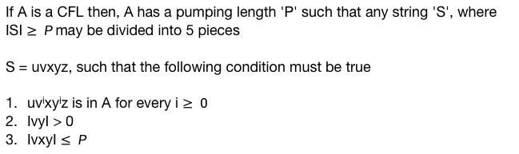
Pumping Lemma for CFL
If A is a CFL then, A has a pumping length 'P' such that any string 'S', where ISI $≥ P$ may be divided into 5 pieces
S = uvxyz, such that the following condition must be true
uv^{i}xy^{i}z is in A for every i $≥ 0$
IvyI > 0
IvxyI $≤ P$
3

Slide 4
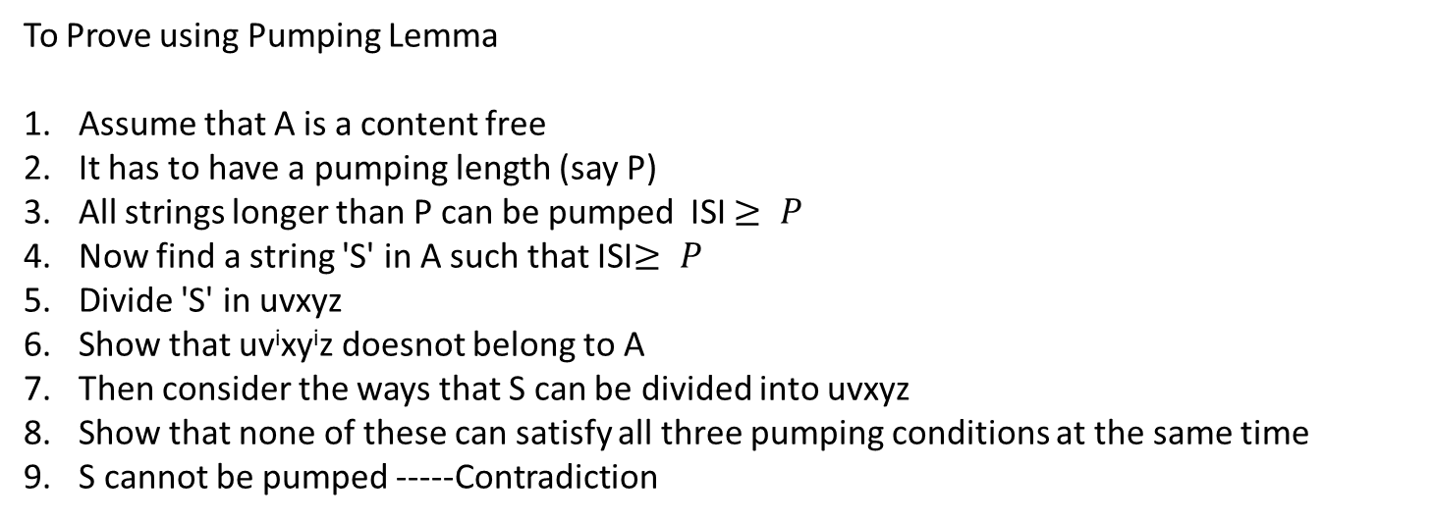
To Prove using Pumping Lemma
Assume that A is a content free
It has to have a pumping length (say P)
All strings longer than P can be pumped ISI $≥ P$
Now find a string 'S' in A such that ISI$≥ P$
Divide 'S' in uvxyz
Show that uv^{i}xy^{i}z doesnot belong to A
Then consider the ways that S can be divided into uvxyz
Show that none of these can satisfy all three pumping conditions at the same time
S cannot be pumped -----Contradiction
3

Slide 5
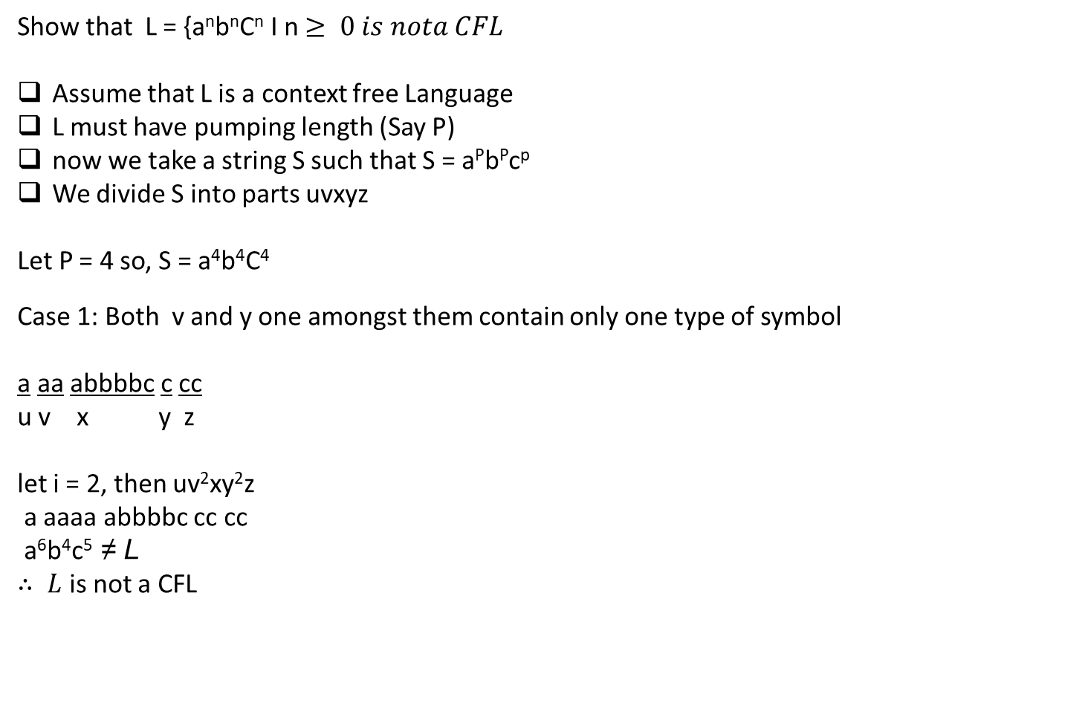
Show that L = {a^{n}b^{n}C^{n} I n $≥ 0 is nota CFL$
Assume that L is a context free Language
L must have pumping length (Say P)
now we take a string S such that S = a^{P}b^{P}c^{p}
We divide S into parts uvxyz
Let P = 4 so, S = a⁴b⁴C⁴
Case 1: Both v and y one amongst them contain only one type of symbol
a aa abbbbc c cc
u v x y z
let i = 2, then uv²xy²z
a aaaa abbbbc cc cc
a⁶b⁴c⁵ ≠ L
$∴ L$is not a CFL
3

Slide 6

Case 2: either v or y has more than one kind of symbols
aa aabb b b cccc
u v x y z
let i = 2, then uv²xy²z
aa aabb aabb b bb cccc
a⁴b²a²b⁴c⁴ ≠ L
$∴ L$is not a CFL
3

Slide 7
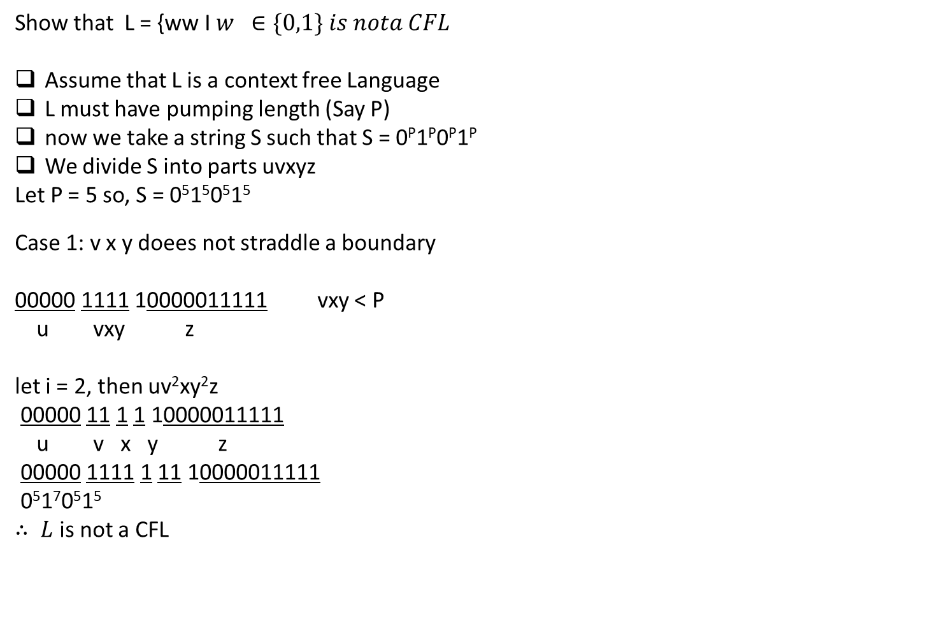
Show that L = {ww I $w ∈\{0,1\} is nota CFL$
Assume that L is a context free Language
L must have pumping length (Say P)
now we take a string S such that S = 0^{P}1^{P}0^{P}1^{P}
We divide S into parts uvxyz
Let P = 5 so, S = 0⁵1⁵0⁵1⁵
Case 1: v x y doees not straddle a boundary
00000 1111 10000011111 vxy < P
u vxy z
let i = 2, then uv²xy²z
00000 11 1 1 10000011111
u v x y z
00000 1111 1 11 10000011111
0⁵1⁷0⁵1⁵
$∴ L$is not a CFL
3

Slide 8

Case 2 a: v x y straddle 1st boundary
000 00111 110000011111 vxy < P
u v x y z
000 00 1 11 110000011111 vxy < P
u v x y z
let i = 2, then uv²xy²z
000 0000 1 1111 10000011111
u v x y z
0⁷1⁷0⁵1⁵
$∴ L$is not a CFL
3

Slide 9

Case 2 b: v x y straddle 3rd boundary
0000011111000 00 1 11 11 vxy < P
u v x y z
let i = 2, then uv²xy²z
0000011111000 0000 1 1111 11
u v x y z
0⁵1⁵0⁷1⁷
$∴ L$is not a CFL
3

Slide 10

Case 3: v x y straddle the mid point
0000011 11100 00011111 vxy < P
u v x y z
0000011 11 1 00 00011111 vxy < P
u v x y z
let i = 2, then uv²xy²z
000000011 1111 1 0000 0001111
u v x y z
0⁵1⁷0⁷1⁵
$∴ L$is not a CFL
3

